Slide 1
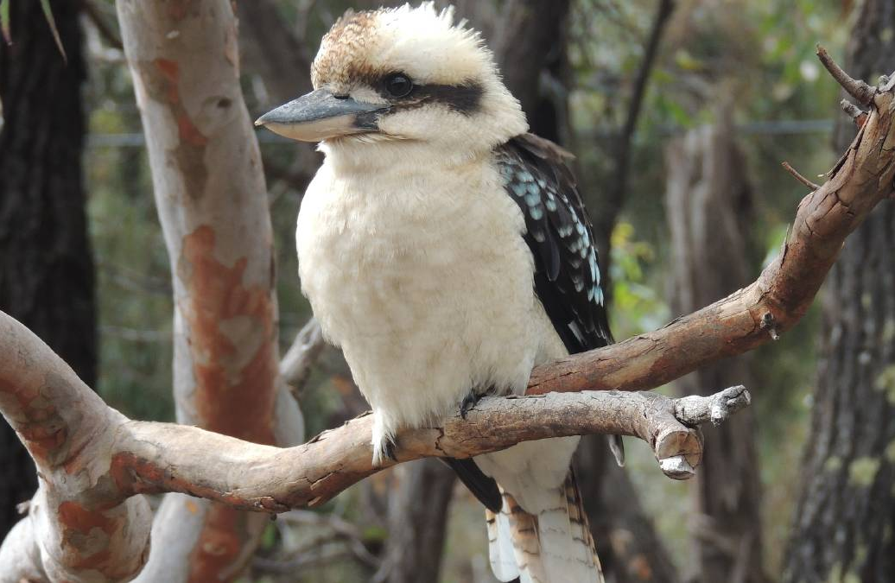
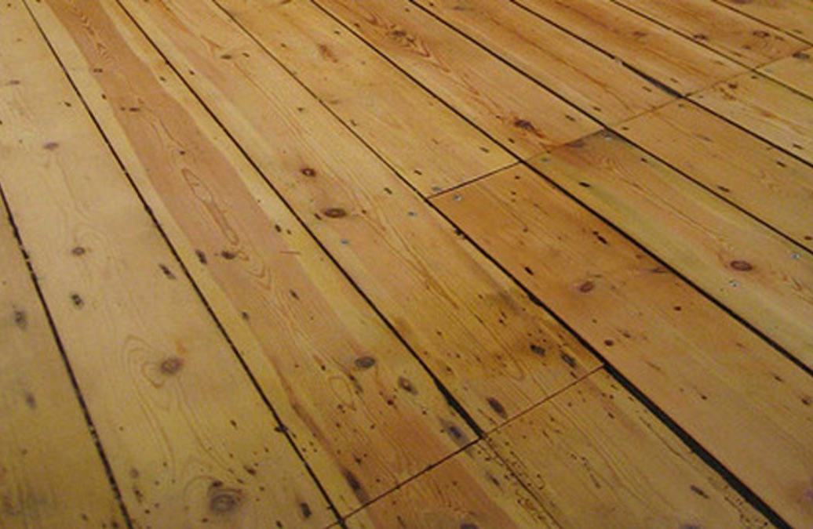
.
Christopher Bauman – www.chrisbauman.com.au

Slide 2
Christopher Bauman – www.chrisbauman.com.au

